Slide 1
Adobe Connect Guide
How to join the meeting

Slide 2
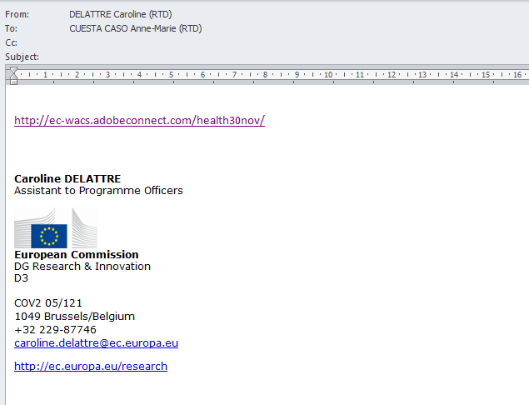
You will receive by email a link from Caroline to follow the presentation.
Just click on the link to join the meeting.

Slide 3
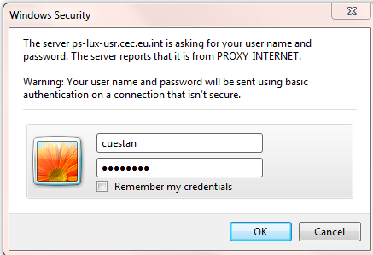
Depending on your proxy-Internet server you may have a security message at this level.
Just enter your own login and password.

Slide 4
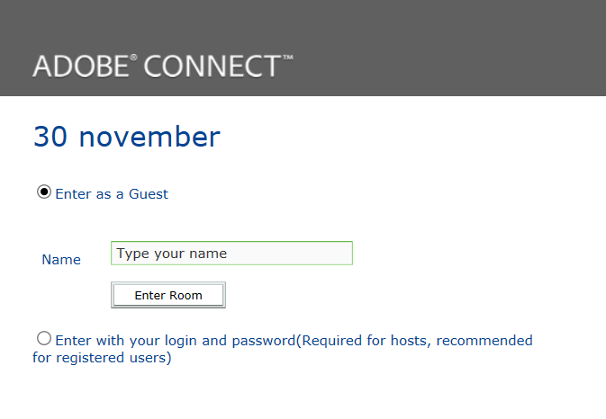
Just type your name.

Slide 5
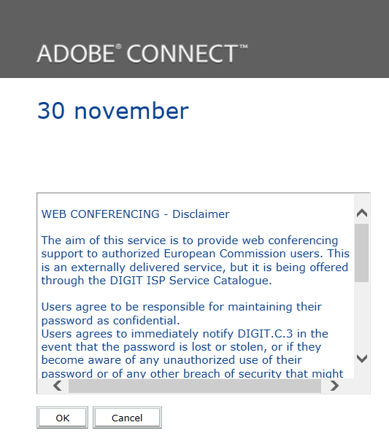

Slide 6
Just close this window !

Slide 7
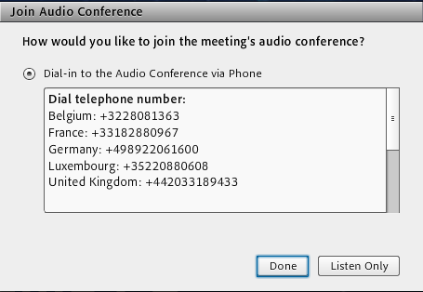
Click on the button Listen Only

Slide 8
Welcome !

